Slide 1



Slide 2
Agenda
Introduction & Dataset Description
1
Data Warehousing
2
Star Schema
3
Data Exploration & EDA
4
Data Analysis & Visualization
5
Business Implications & Key Findings
6
SIMRAN

Slide 3
Client Overview
Industry
Hospitality and Short-term Residential Rentals
Platform for hosting and booking accommodations globally
Core Business
Airbnb operates an online marketplace for lodging, primarily homestays for vacation rentals, and tourism activities
Service Overview
Leader in global market for travel and short-term rentals booking
Market Position
SIMRAN
May

Slide 4




Benefits of Solution
Competitive Edge
Data-Driven Decisions
Business Growth
SIMRAN

Slide 5
Warehouse Design
Warehouse Design
SIDDHARTH

Slide 6
Overview of Dataset
 | Original Dataset | Transformed Dataset
Number of Rows | 494954 | 1476500
Number of Columns | 89 | 34
What does the Dataset look like?
Category | Columns Name
Listing | ID, Year, Name, Property Type, Latitude, Longitude
Host | Host ID, Name, Response Time, Listing count, Host Since
Location | Street, City, Zip Code, Country, Neighbourhood
Property | Room Type, Accommodates, Bathrooms, Bedrooms, Beds, Area
Availability | Is Available, Available 30, Available 60, Available 365
Reviews | No. of reviews, First review, last review, Rating, Review Scores
SIDDHARTH

Slide 7




Data Description
ID, Year, Host ID, City, Price, Cleaning Fee, Revenue, Number of Bookings till Date, Reviews per Month, Host Response Time Quantified, Number of Reviews, Guests Included, Minimum Nights, Security Deposits, and more
Data Grain
Facts
Dimension
One row per listing per year captures the annual performance metrics of an individual Airbnb listing
Listing Dimension
Host Dimension
Location Dimension
SIDDHARTH
Notes:
Speaker: Siddharth Starting with the Data Grain. Here, each record captures an individual transaction or customer interaction. It sheds light on their preferences, booking tendencies, and offers a deeper understanding of what drives their satisfaction. This level of granularity allows us to measure Airbnb's performance and its competitiveness in the market with precision.
Moving on to the Facts section, these are the quantifiable metrics we're tracking. We look at variables like the price of a listing, the service fees involved, the length of each stay, and the total booking value. We're also considering the number of guests per booking, whether there was a cancellation—indicated by the Cancellation Flag—as well as the payment method used, any security deposit held, and the cancellation fee applied if any. These facts are the hard numbers that will feed into our analytical models and provide the backbone for our insights.
Bookings Fact Table Reviews Fact Table: Transactions Fact Table: Bookings and Reviews tables
Lastly, we turn our attention to the Dimensions. These are the broader categories that provide context to our facts. They include Listing Details, which encompass the specifics of each property, such as its type, location, amenities, and availability. The Customer dimension encapsulates the demographic profile of the guests, their booking history, and any reviews they might have left. The final dimension, Demographics Market Environment, examines the macro-level factors such as regional tourism trends, seasonal influences, and economic indicators that could affect Airbnb's market.

Slide 8
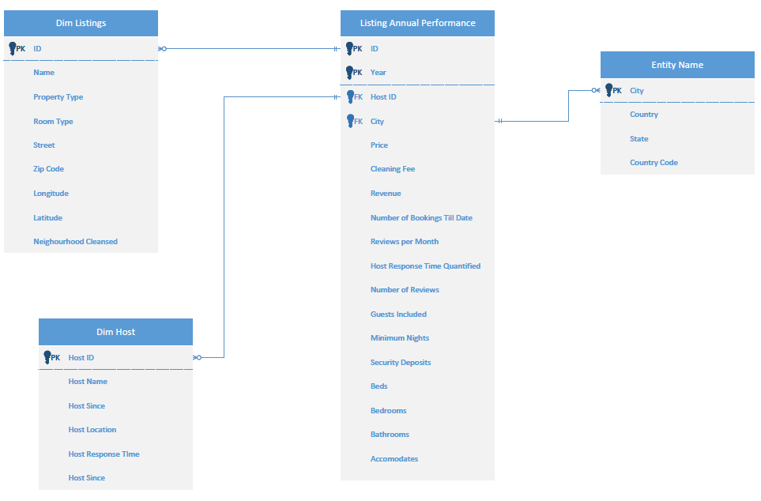
Star Schema
SIDDHARTH
Notes:
Speaker: Manas

Slide 9
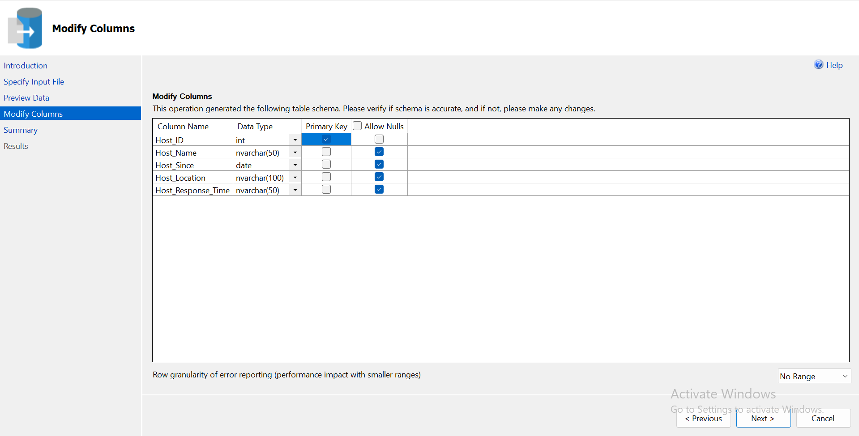
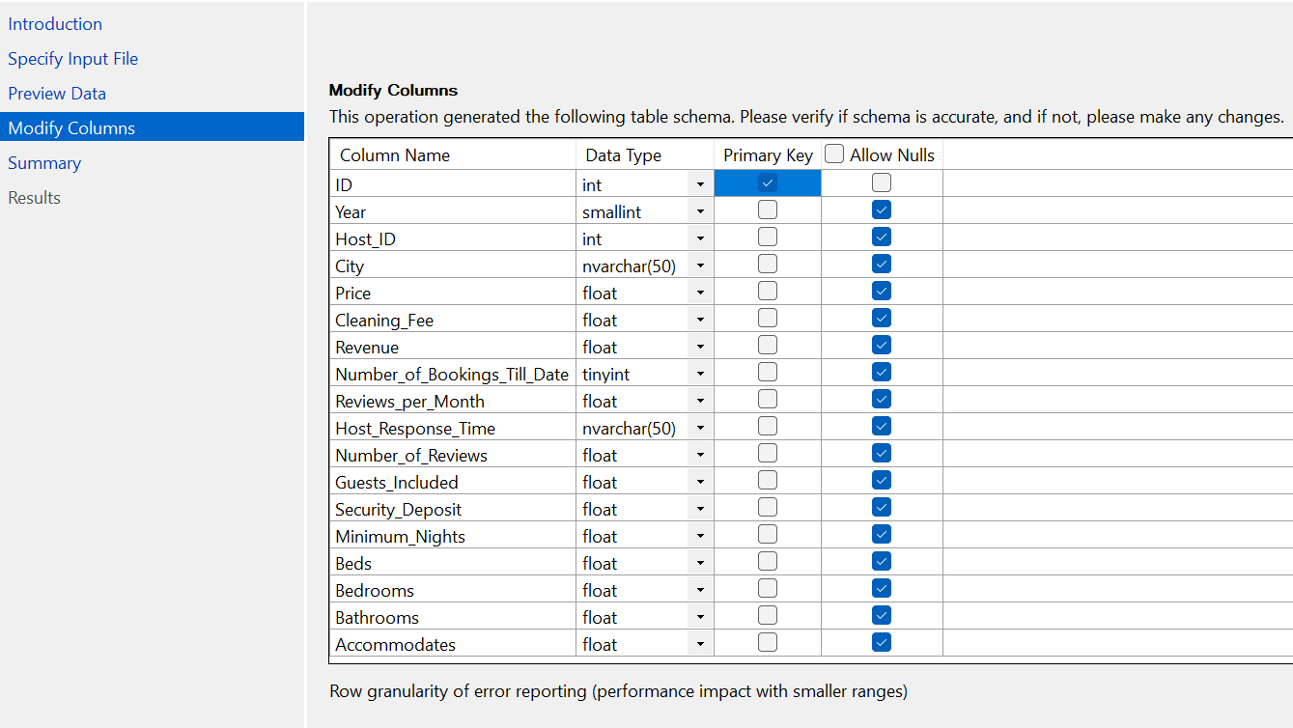
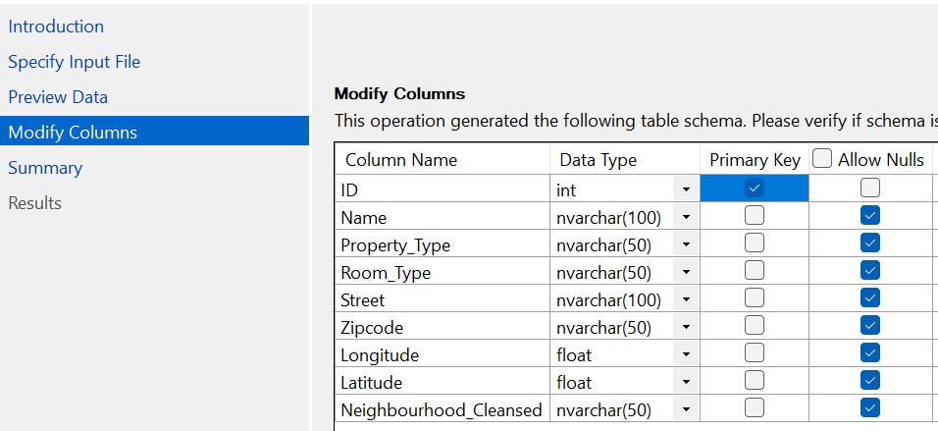
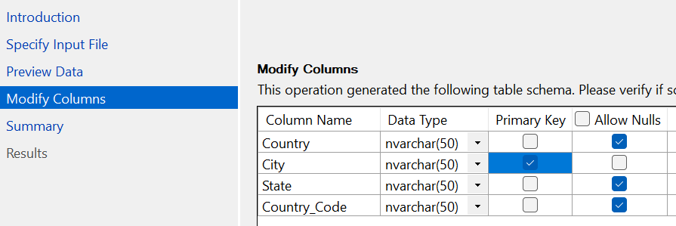
Importing Flat Files into SSMS
SIDDHARTH

Slide 10
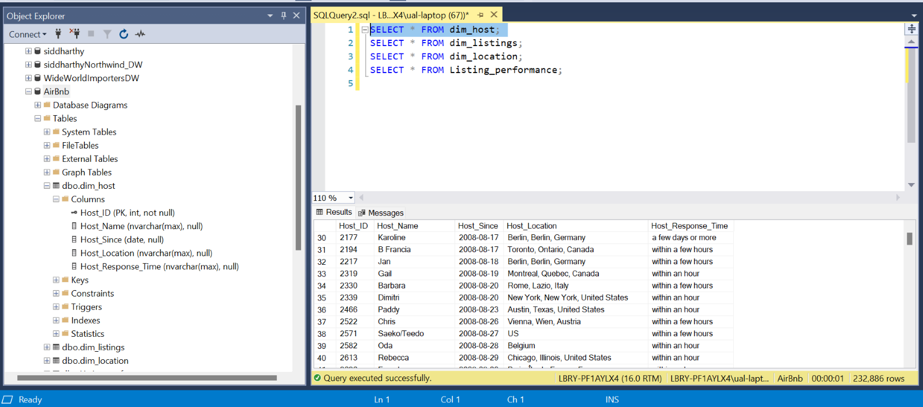
Dimension Table: Host
SIDDHARTH

Slide 11
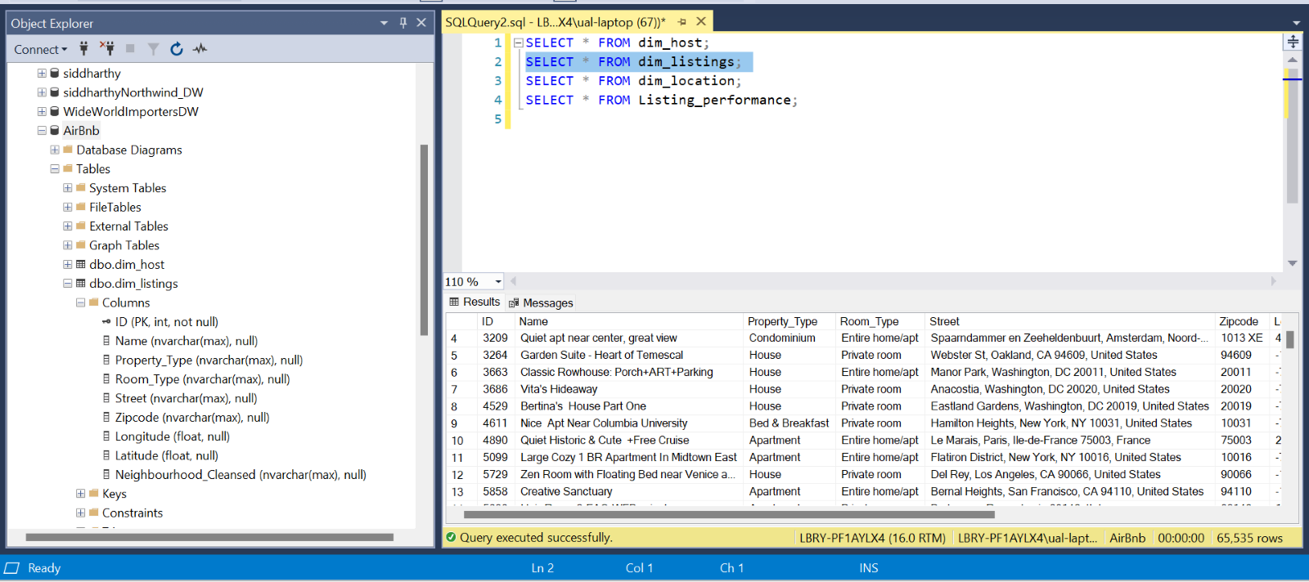
Dimension Table: Listings
SIDDHARTH

Slide 12
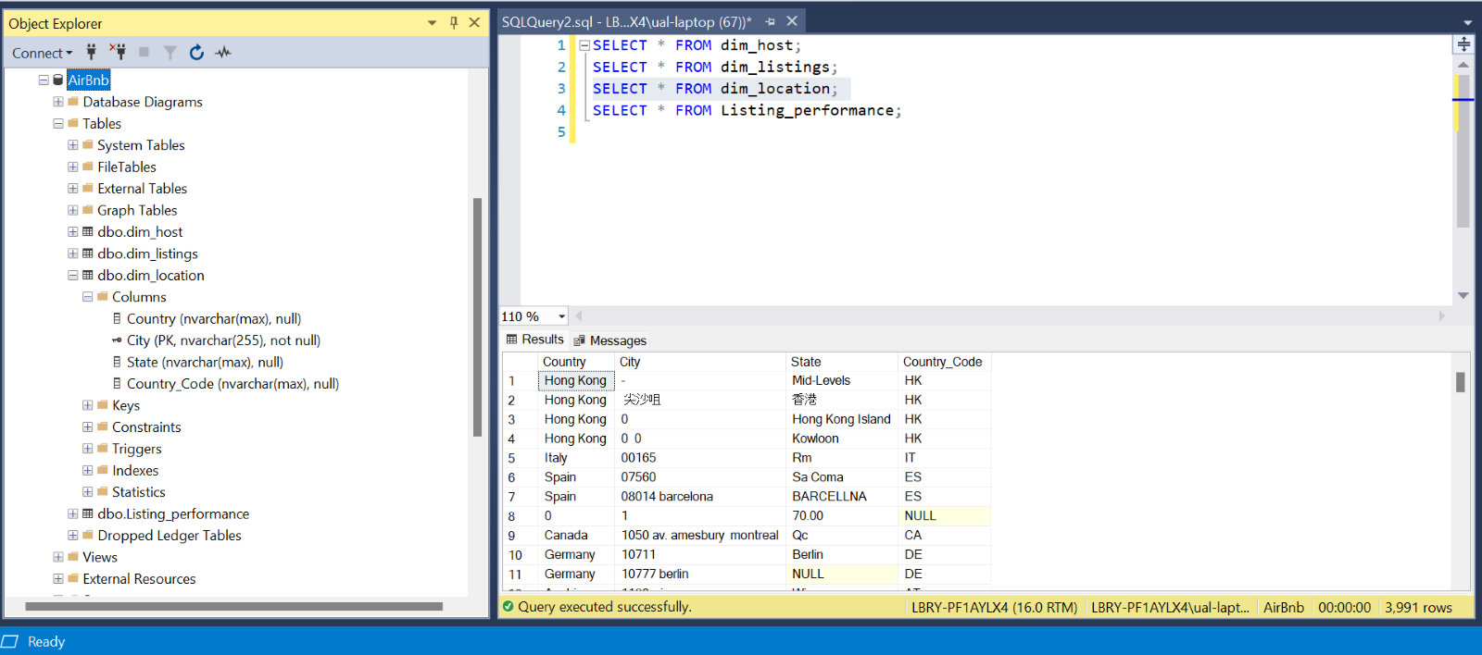
Dimension Table: Location
SIDDHARTH

Slide 13
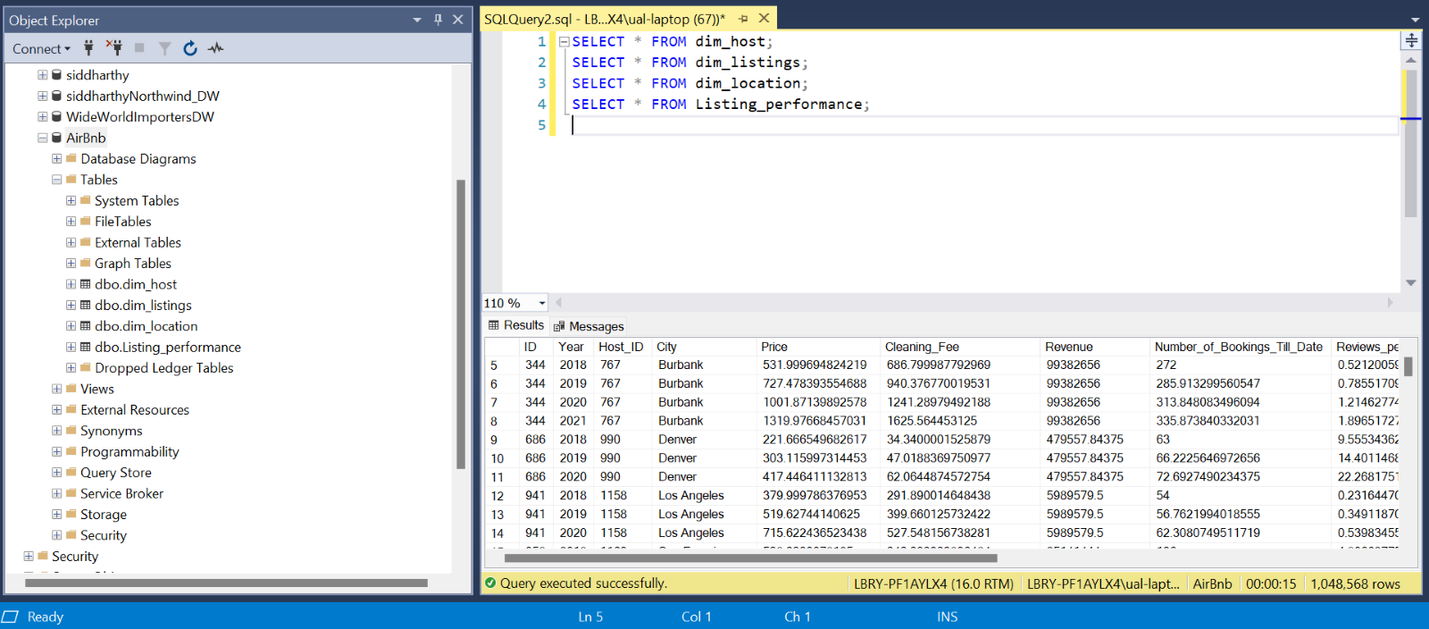
Fact Table
SIDDHARTH

Slide 14
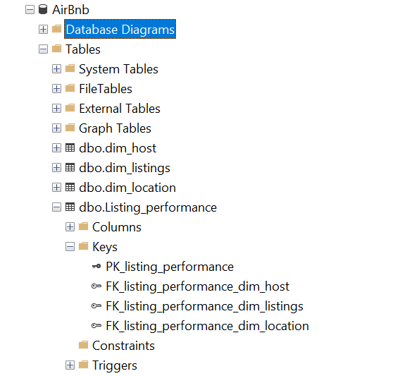
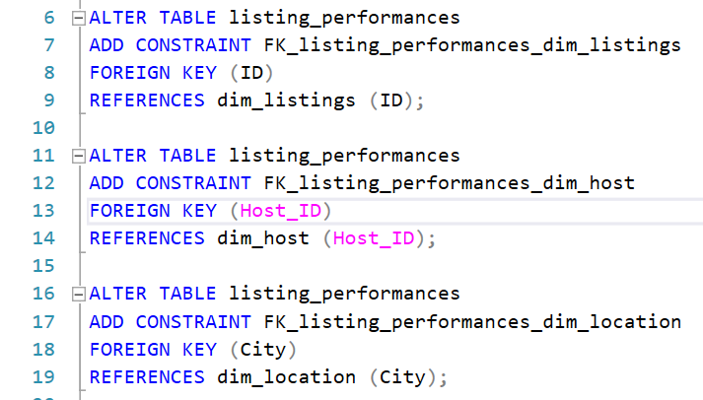
Implementing Foreign Keys
SIDDHARTH

Slide 15
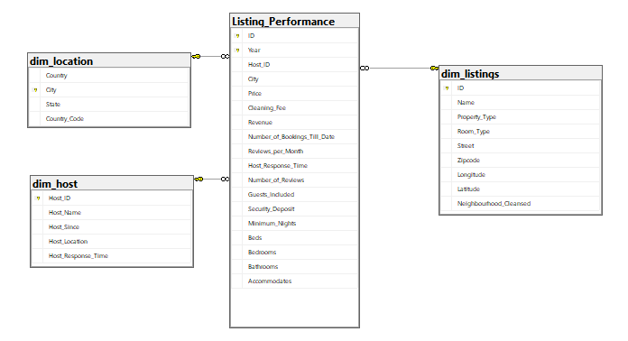
Star Schema: SSMS
SIDDHARTH

Slide 16
Descriptive Statistics
Data Preparation & Exploration
Data Preprocessing
Data Transformation
Visual Exploration
PRANIT

Slide 17
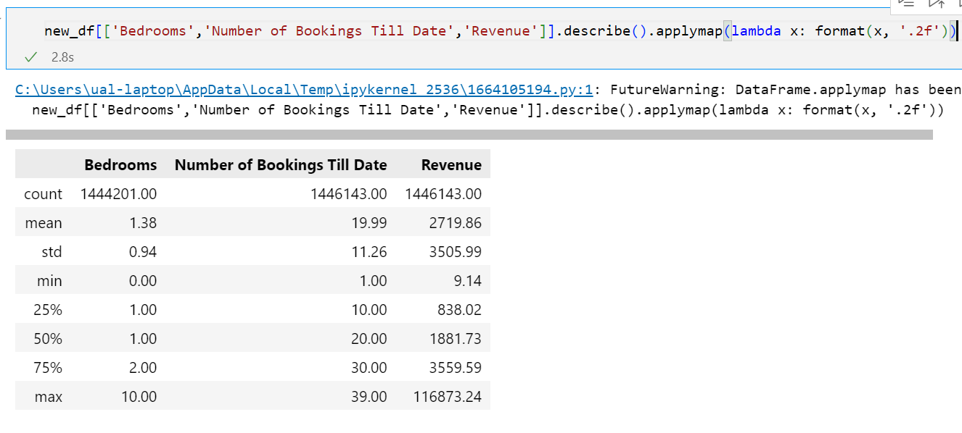
Descriptive Statistics
PRANIT

Slide 18
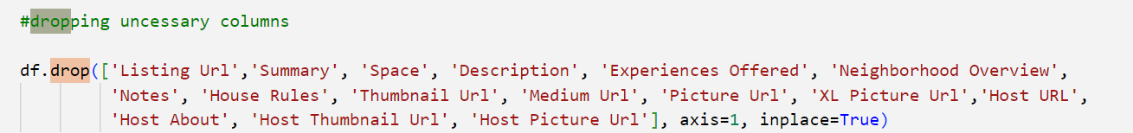
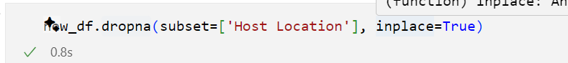
Data Preprocessing
Handling Null Values
1. Dropping Unnecessary Columns
2. Dropping NA from Columns ​
PRANIT

Slide 19
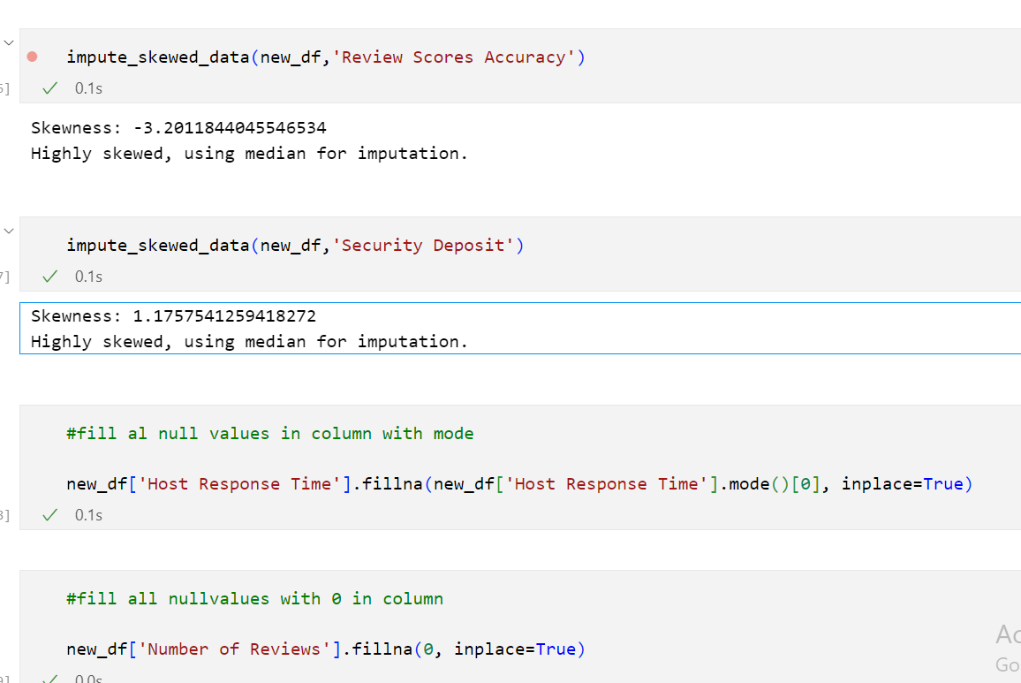
Data Preprocessing
Handling Null Values
3. Imputing Null Values ​
PRANIT

Slide 20
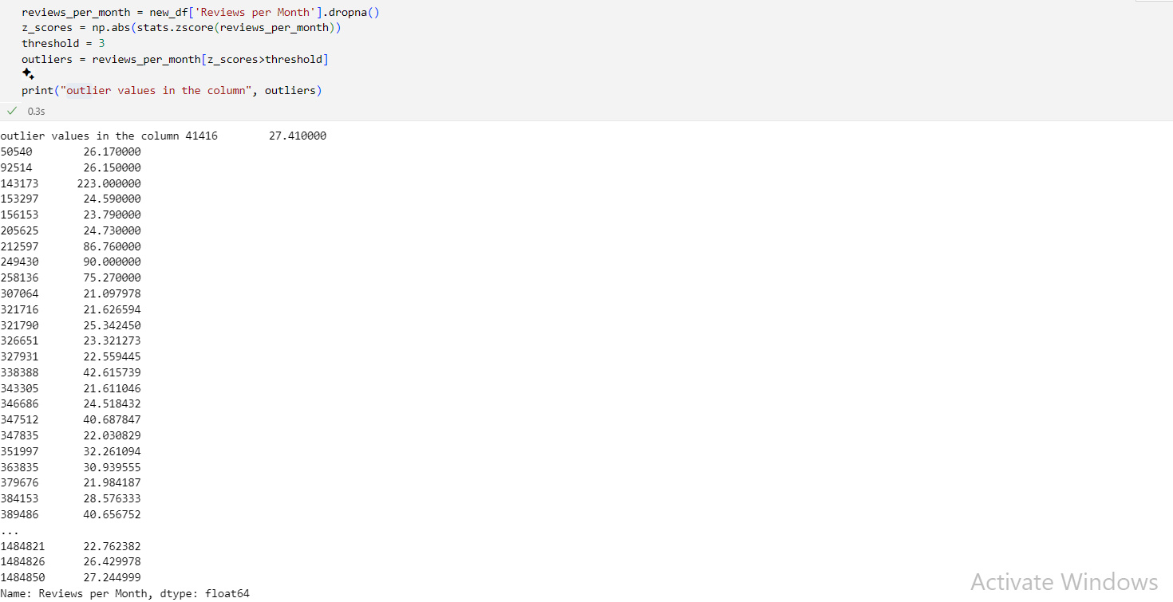
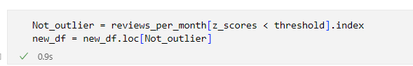
Data Preprocessing
Outlier Detection
PRANIT

Slide 21
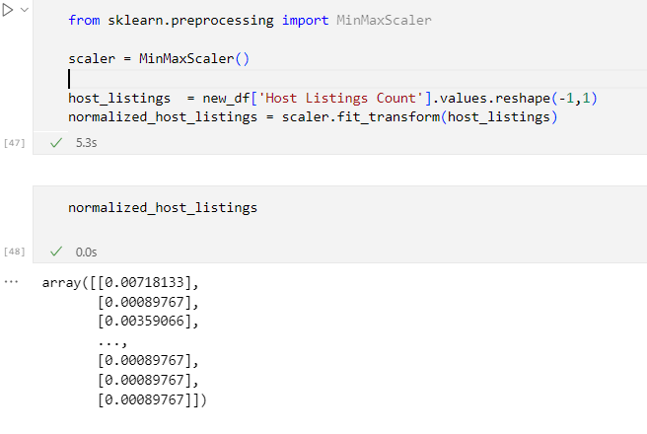
Data Transformation
Scaling
PRANIT

Slide 22
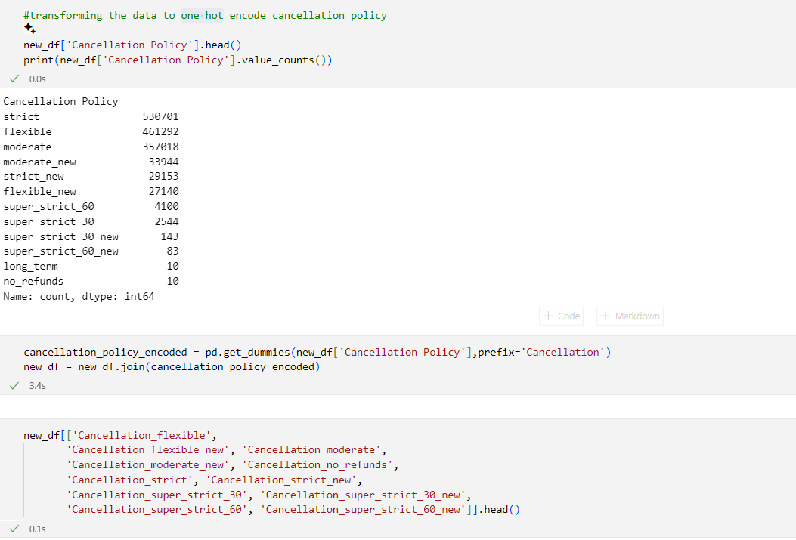
Data Transformation
One-hot Encoding
PRANIT

Slide 23
Derived Columns
No. of Bookings till Date
Revenue
Host Time Quantified
Temporal Data
PRANIT

Slide 24
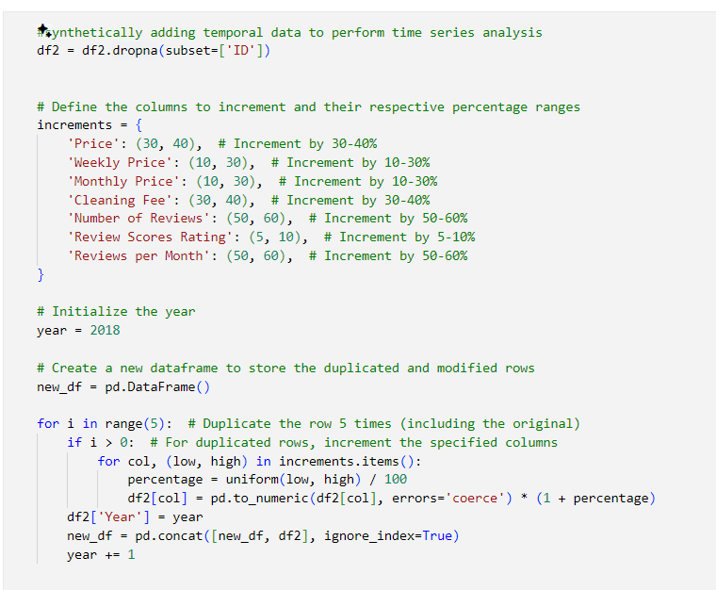
Derived Columns
For synthetically adding temporal data
Added temporal data to facilitate time series analysis
PRANIT

Slide 25
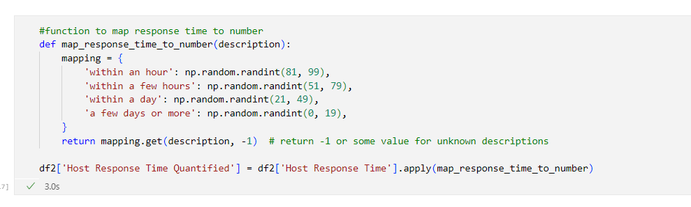
Derived Columns
Creating a new column by quantifying existing host response time columns
Derived from the 'Host Response Time' column
Categorical responses are mapped to numerical values to quantify response times, with a random number generated within specified ranges for each category.
PRANIT

Slide 26
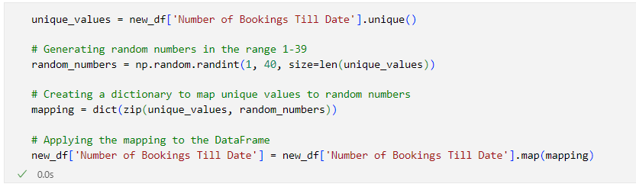
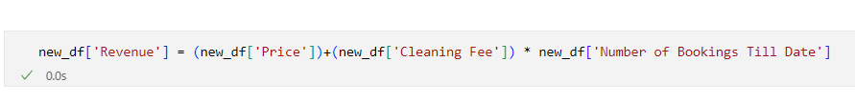
Derived Columns
For synthetically calculating revenue from the existing columns
Selected Unique values from all rows.
Randomly generated to simulate the actual number of bookings, with values 0 to 40.
Calculated as 'Price' + 'Cleaning Fee' * with the derived column 'Number of Bookings Till Date' to estimate the total revenue generated by a listing.
PRANIT

Slide 27
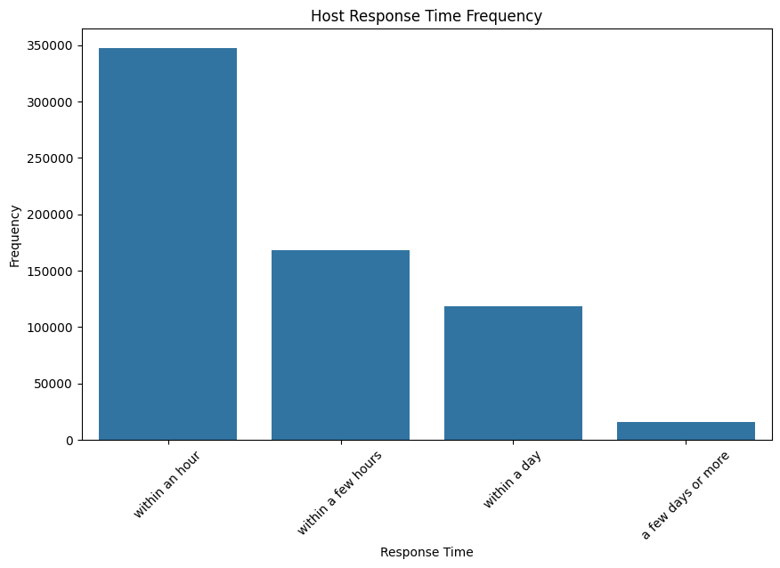
Visual – Bar Graph
#Host response time frequency
plt.figure(figsize=(10, 6))
sns.countplot(x='Host Response Time', data=df, order=df['Host Response Time'].value_counts().index)
plt.title('Host Response Time Frequency')
plt.xlabel('Response Time')
plt.ylabel('Frequency')
plt.xticks(rotation=45)
plt.show()
Hosts are most likely to respond to messages within an hour
SIMRAN
Notes:
Speaker: Pranit

Slide 28
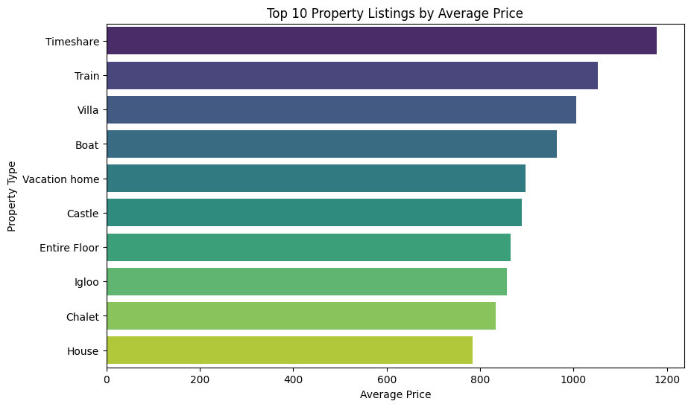
Visual – Horizontal Bar Chart
# Plot bar plot
plt.figure(figsize=(10, 6))
sns.barplot(x=top_10_avg_price_by_property.values, y=top_10_avg_price_by_property.index, palette='viridis')
plt.title('Top 10 Property Listings by Average Price')
plt.xlabel('Average Price')
plt.ylabel('Property Type')
plt.show()
Most expensive property type is a timeshare and the least expensive is a house to stay
SIMRAN
Notes:
Speaker: Pranit

Slide 29
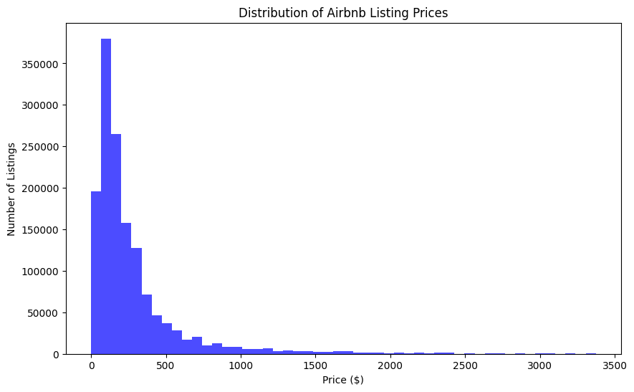
Visual - Histogram
# Create a histogram of the Price column
plt.figure(figsize=(10, 6))
plt.hist(data['Price'], bins=50, color='blue', alpha=0.7)
plt.title('Distribution of Airbnb Listing Prices')
plt.xlabel('Price ($)')
plt.ylabel('Number of Listings')
# Show the histogram
plt.show()
There are more affordable Airbnbs available than expensive ones
SIMRAN
Notes:
Speaker: Pranit

Slide 30
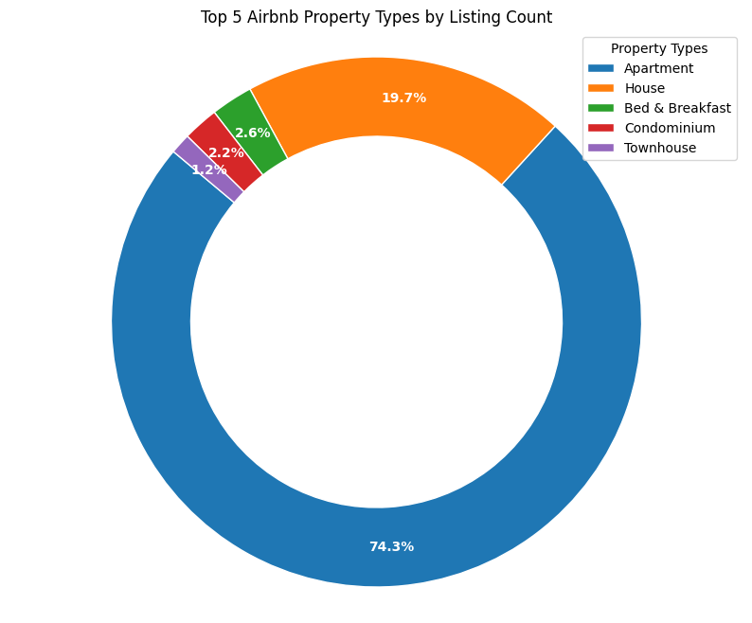
Visual- Donut Chart
plt.figure(figsize=(10, 8))
wedges, texts, autotexts = plt.pie(top_property_types, autopct='%1.1f%%', pctdistance=0.85, startangle=140)
plt.setp(wedges, width=0.3, edgecolor='white') plt.setp(autotexts, size=10, weight="bold", color="white") plt.title('Top 5 Airbnb Property Types by Listing Count')
plt.axis('equal')
plt.legend(top_property_types.index, title="Property Types", loc="upper right", bbox_to_anchor=(1, 1)) plt.show()
Apartments are the most common type of Airbnb property listing
SIMRAN
Notes:
Speaker: Pranit

Slide 31
Warehouse Design
Data Analysis & Visualization
MANAS

Slide 32
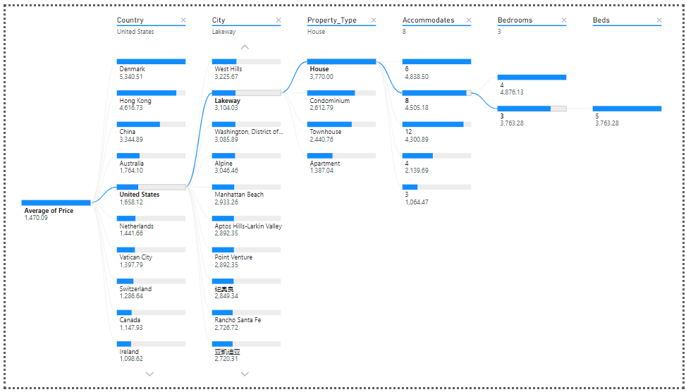


Data Analysis & Visualizations
Visualization: Decomposition Tree
Stakeholders: Airbnb market analysts and listing owners
MANAS

Slide 33
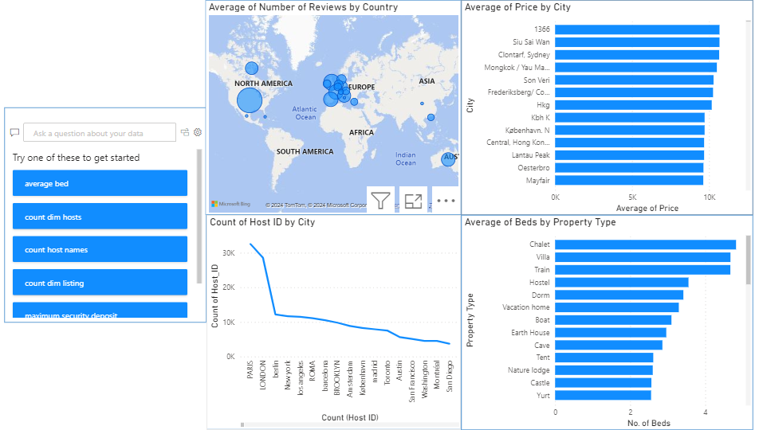
Data Analysis & Visualizations
Visualization: Q&A
Stakeholders: Customers, hosts (property owners), real estate investors, and urban development agencies
MANAS

Slide 34
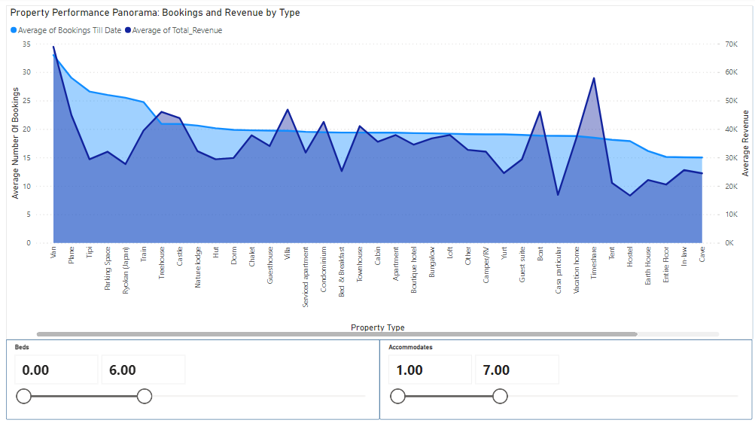
Data Analysis & Visualizations
Visualization: Area Chart
Stakeholders: Hosts, market analysts and real estate agents
MANAS

Slide 35
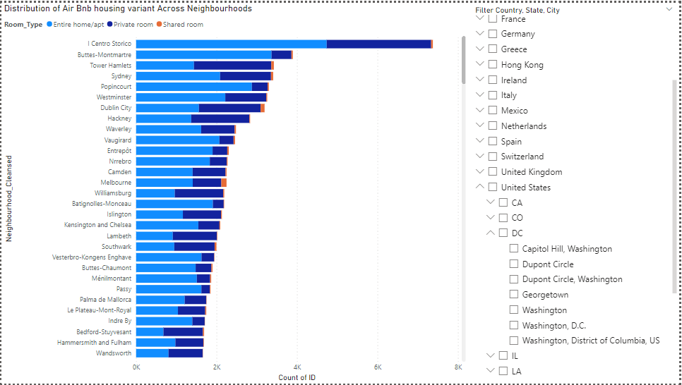
Data Analysis & Visualizations
Visualization: Stacked Bar Chart
Stakeholders: Management Team at Airbnb, Policy and Compliance Teams, Marketing Team
MANAS

Slide 36
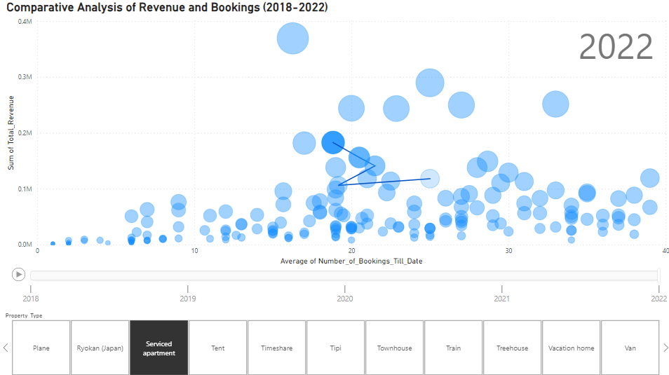
Data Analysis & Visualizations
Visualization: Scatterplot using Play Graph
Stakeholders: Hosts, Airbnb Team, Real Estate Agents and Airbnb Finance Department
MANAS

Slide 37

Data Analysis & Visualizations
Visualization: Scatterplot using Play Graph
Stakeholders: Hosts, Airbnb Team, Real Estate Agents and Airbnb Finance Department
MANAS

Slide 38
Warehouse Design
Predictive Modelling
GAURAV

Slide 39
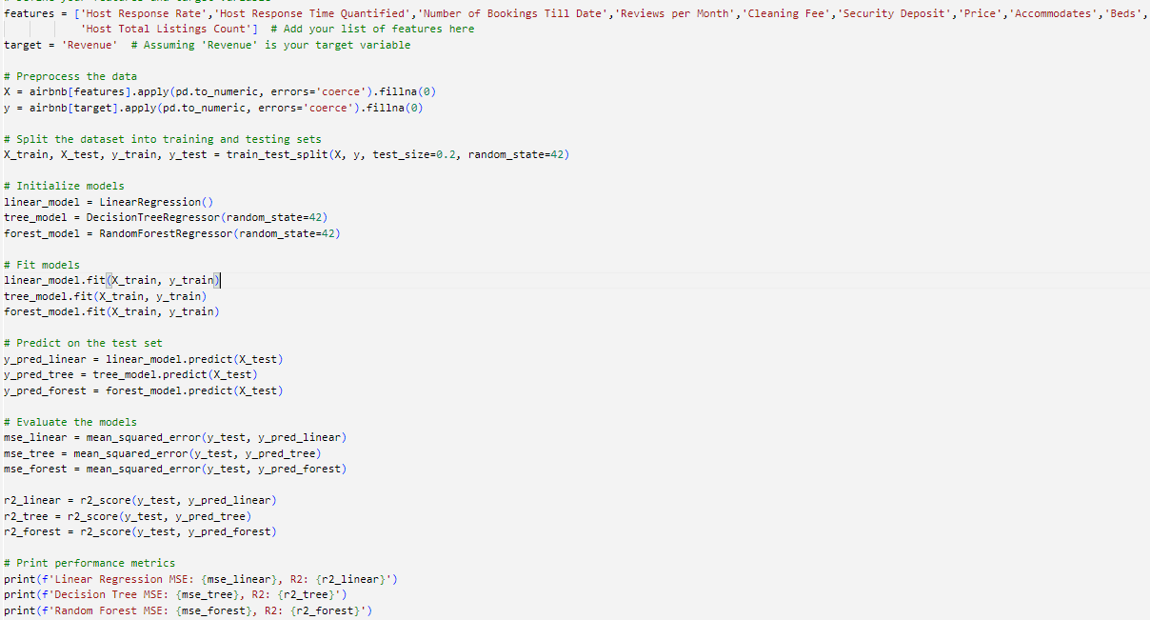
Predictive Modelling
GAURAV

Slide 40
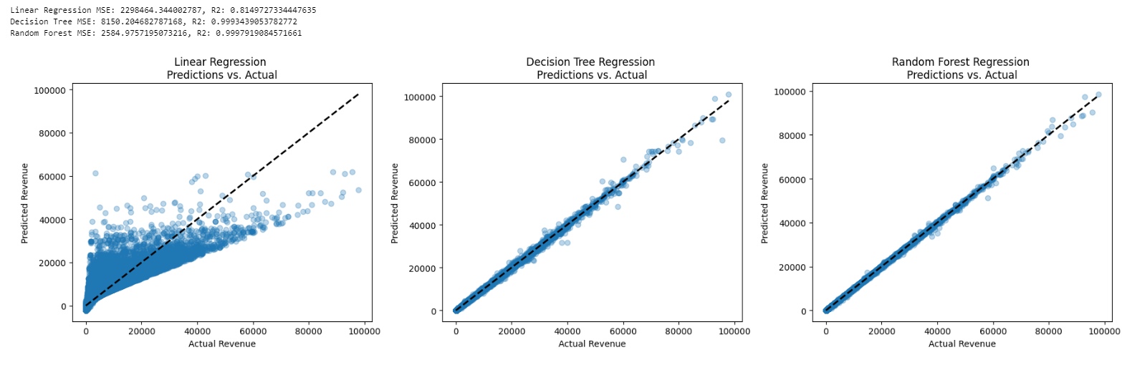
Predictive Modelling
GAURAV

Slide 41
Warehouse Design
Business Implications
GAURAV

Slide 42



Business Implications & Key Insights
GUEST SATISFACTION
HOST PERFORMANCE​
LISTING OPTIMIZATION​
​
By analyzing reviews, Airbnb could identify potential super hosts or areas where hosts may need additional support or training.
Analysis can highlight what guests are looking for in an Airbnb and what kind of listings are most successful.
By analyzing 'Year', 'Number of Bookings', and 'Revenue', yearly insights can be gained, helping hosts to adjust pricing or availability accordingly.
GAURAV

Slide 43




Applications
Performance
Analytics
Demand
Forecasting
Property
Popularity Metrics
Dynamic
Pricing

Slide 44


Data Analysis
Demand Fluctuation Analysis
Geographical Analysis
Pricing Elasticity
4. Market Trends and Dynamics
Demand Forecasting
Price Optimization
Customer Satisfaction Prediction
5. Predictive Modeling
6. Business Implications
Translate analytical findings into actionable business insights
Provide recommendations
Notes:
Speaker: Simran

